Slide 1
Education Analytics using OULAD Dataset and Alumni Analytics
-VARSHINI PRIYA M

Slide 2
CERTIFICATE
This is to certify that the project report titled “EDUCATION ANALYTICS”
is a bonafide work carried out by Mrs. Varshini Priya M in partial fulfillment of the
requirements for the award of the course of DATA ANALYTICS of AIMORE TECHNOLOGIES during the academic year 2026.
This project work has been carried out under my supervision and guidance. The work embodied in this report is original and has not been submitted to any other University or Institution for the award of any degree or diploma.
Guide Name: MOHIDEEN JAILANI

Slide 3
DECLARATION
I hereby declare that the project report titled “EDUCATION ANALYTICS” submitted by
me to AIMORE TECHNOLOGIES is a record of original work carried out by me under
the guidance of MOHIDEEN JAILANI.
I further declare that this project report has not been submitted previously,
either in full or in part, to any other University or Institution for the award of any degree,
diploma, or fellowship.
All sources of information used in this project report have been duly acknowledged.
Place: Erode
Date: 19-01-2026

Slide 4
INTRODUCTION
Educational institutions generate large volumes of academic data
Traditional reporting fails to extract meaningful insights
Education analytics supports informed decision-making

Slide 5
PROBLEM STATEMENT
Difficulty in identifying at-risk students
Limited insight into admission and enrollment trends
Alumni placement and contribution data underutilized

Slide 6
OBJECTIVES
Analyze student academic performance
Identify at-risk students
Study admission and enrollment trends
Analyze workload and performance of faculty
Analyze alumni placement and contribution

Slide 7
DATASET DESCRIPTION
OULAD Student Dataset
Admissions Dataset
Alumni Information Dataset
Faculty workload Dataset
Placement and Alumni Contribution Datasets

Slide 8
TOOLS USED
Python (Pandas, NumPy)
Power BI (DAX, Dashboards)
CSV-based structured datasets

Slide 9
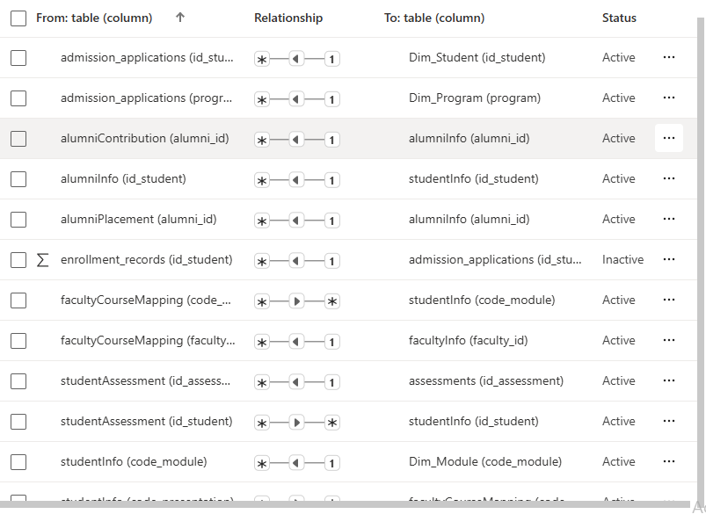
DATA MODEL

Slide 10

STUDENT PERFORMANCE OVERVIEW
PURPOSE :
Understand learning outcomes, identify weak students, and track academic trends.
This dashboard provides a comprehensive overview of student academic performance using the OULAD dataset. Key indicators such as pass rate, fail rate, and withdrawal rate help identify overall institutional effectiveness. Visualizations like score distributions and module-wise performance highlight difficult courses and student learning gaps.

Slide 11
DROPOUT AND RISK ANALYTICS
PURPOSE :
Early warning system for at-risk students.
The dropout analytics dashboard focuses on identifying students at risk of discontinuing their studies. Behavioral indicators such as declining LMS activity and missed assessments are analyzed. Predictive models assist academic administrators in early intervention.
.

Slide 12
E-LEARNING PLATFORM USAGE
This dashboard evaluates students’ engagement with the online learning platform. Usage trends, content popularity, and engagement-performance correlations help improve instructional design and digital resource allocation.
PURPOSE:
Measure digital engagement & content effectiveness.

Slide 13
FACULTY WORKLOAD AND PERFORMANCE
Purpose
Optimize teaching load and evaluate effectiveness.
Faculty workload and performance dashboards ensure equitable distribution of teaching responsibilities while monitoring instructional effectiveness. Insights support evidence-based faculty planning and professional development.

Slide 14
ADMISSION AND ENROLLMENT TRENDS
PURPOSE:
Understand admission funnel and enrollment growth.
This dashboard provides insights into student application behavior ,admission outcomes and enrollment performance.

Slide 15
ALUMNI PLACEMENT AND CONTRIBUTION
Objective
Alumni placement and contribution analytics assess institutional outcomes beyond graduation. Placement success, salary trends, and alumni engagement reflect program quality and long-term institutional impact.

Slide 16
KEY INSIGHTS
Higher engagement leads to better outcomes
Certain departments show stronger placement
Successful alumni contribute more

Slide 17
CONCLUSION AND FUTURE SCOPE
Project enables data-driven academic planning
Future scope includes predictive analytics and real-time dashboards

Slide 18
THANK YOU ANY QUESTIONS?

